Slide 1
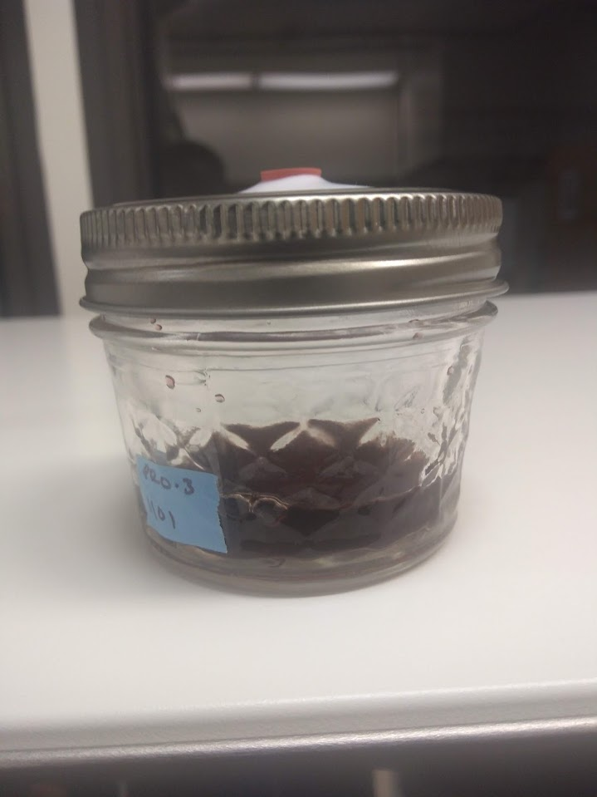
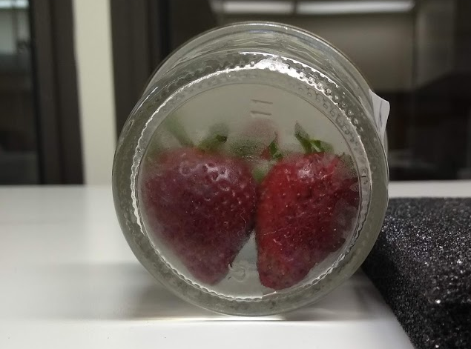
Additive microbe studies to elucidate semiochemicals responsible for attractive and/or repellent effects on Drosophila suzukii

Slide 2
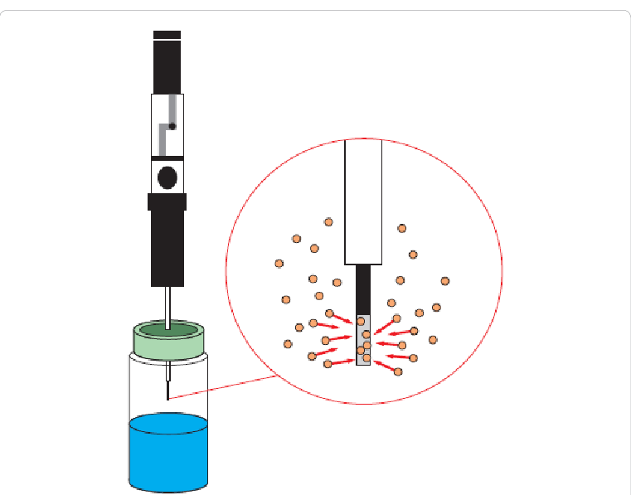
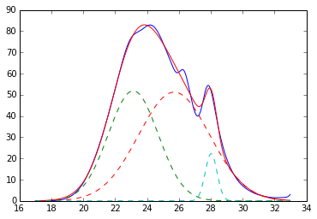
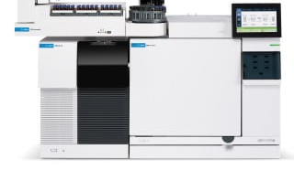
Sampling Inoculated Broth Mixes
 | 100% LB Broth | 10% Juice in LB Broth | Time Point
F. faeni | 27 | 30 | 2H, 24H, and 48H
P. agglormeans | 25 | 28 | 2H, 24H, and 48H

Slide 3
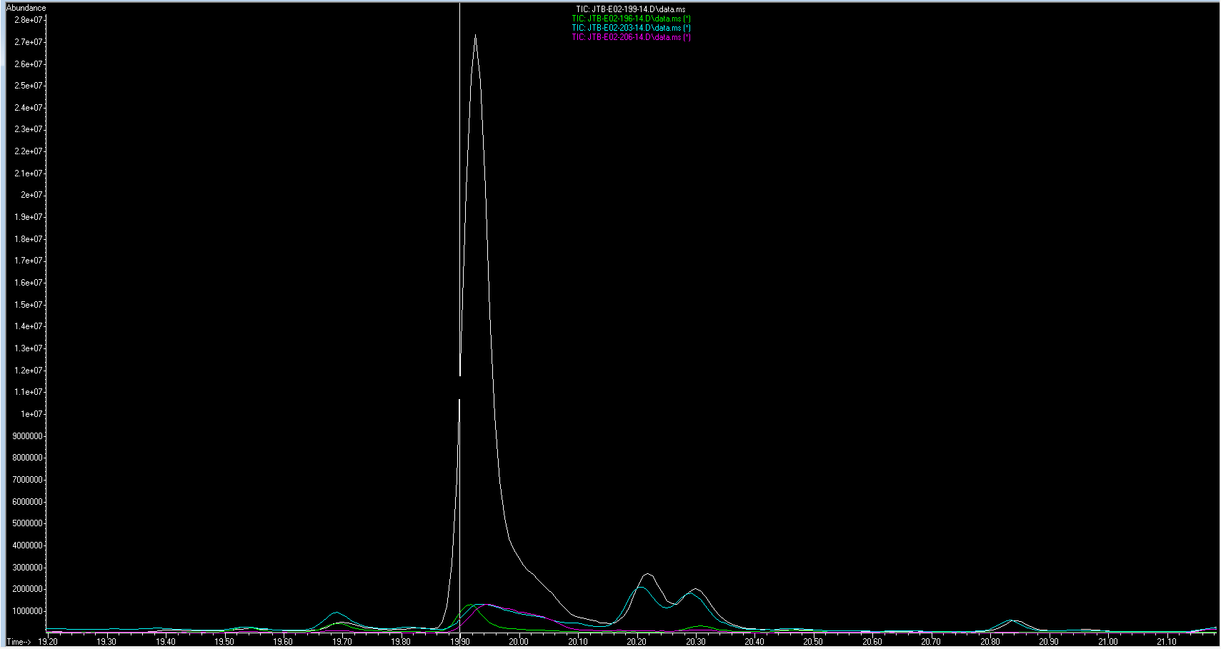
Volatile Emission 2-hours After Inoculation
F. faeni
1.2mL Juice and 10.8mL of LB broth
RT=18.122
Furfural

Slide 4
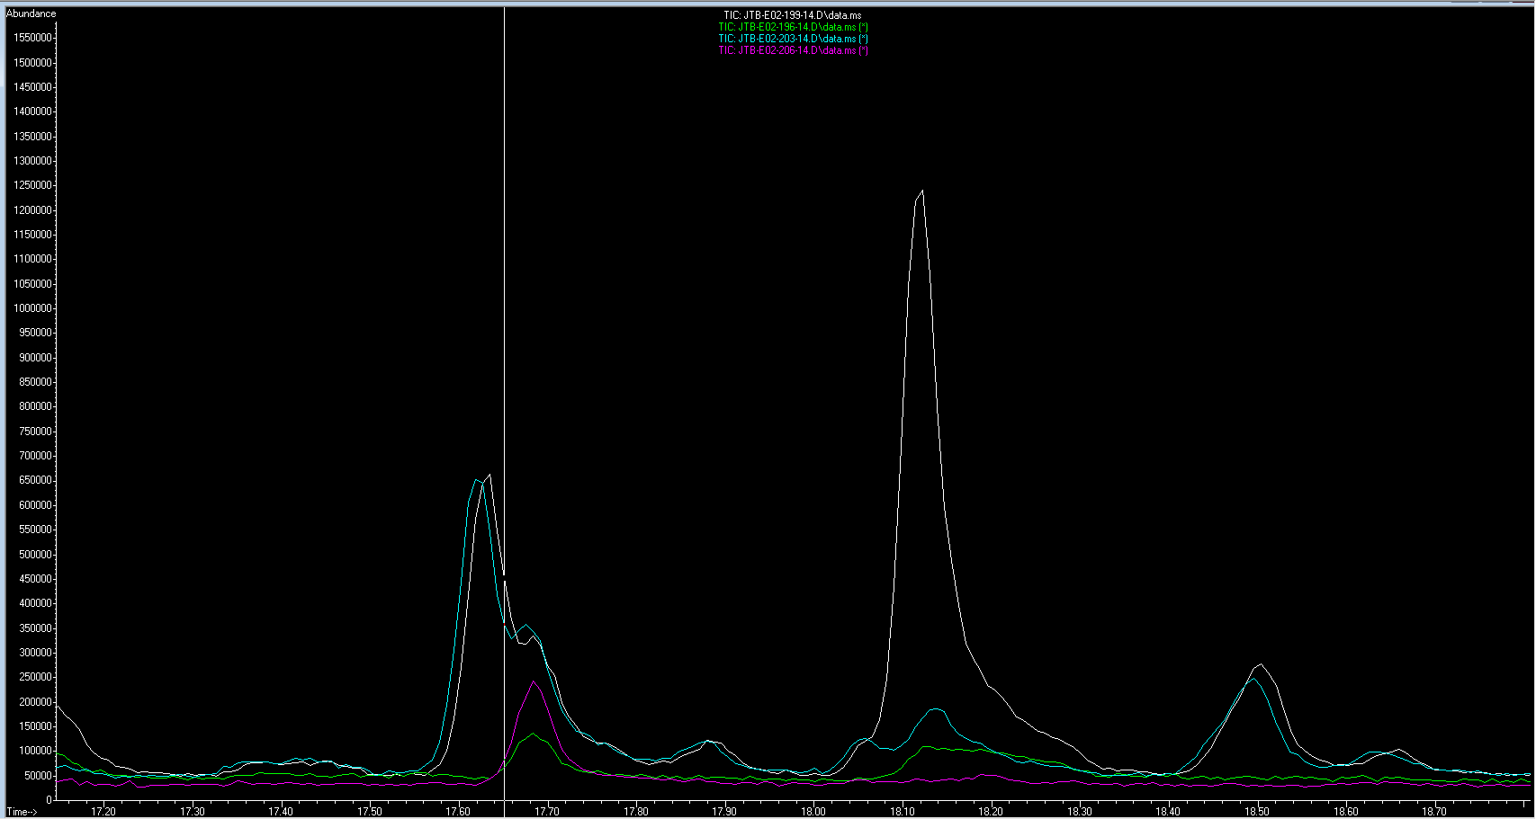
Volatile Emission 2-hours After Inoculation
F. faeni
1.2mL Juice and 10.8mL of LB broth
RT=19.917
Benzaldehyde

Slide 5
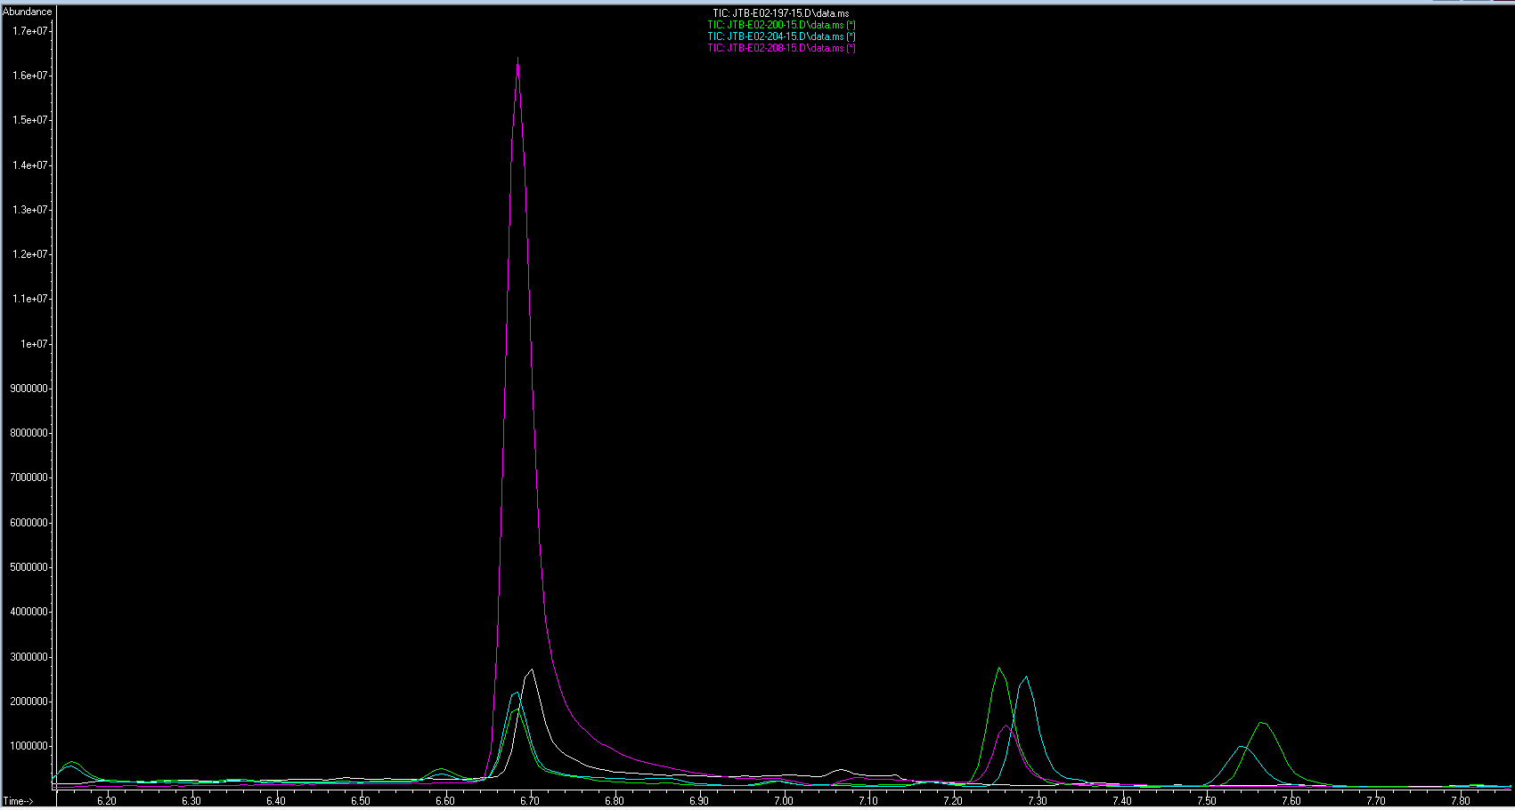
Volatile Emission 24-hours After Inoculation
P. agglormeans
1.2mL Juice and 10.8mL of LB broth
RT= 6.685
Dimethyl disulfide

Slide 6
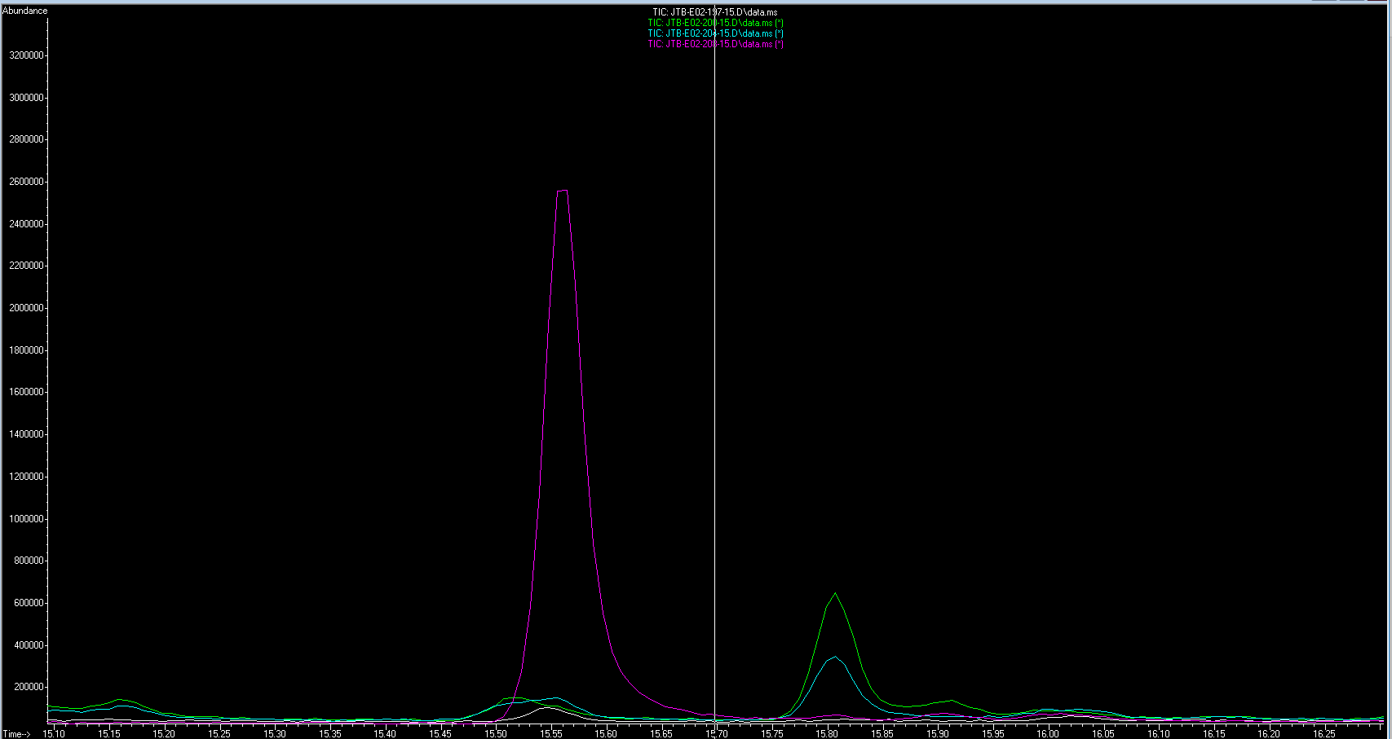
Volatile Emission 24-hours After Inoculation
P. agglormeans
1.2mL Juice and 10.8mL of LB broth
RT= 15.563
Dimethyl trisulfide

Slide 7
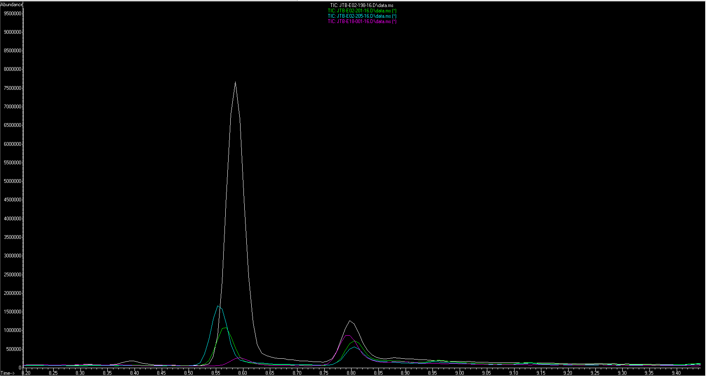
Volatile Emission 48-hours After Inoculation
F. faeni
1.2mL Juice and 10.8mL of LB broth
RT= 8.586
1-Butanol

Slide 8
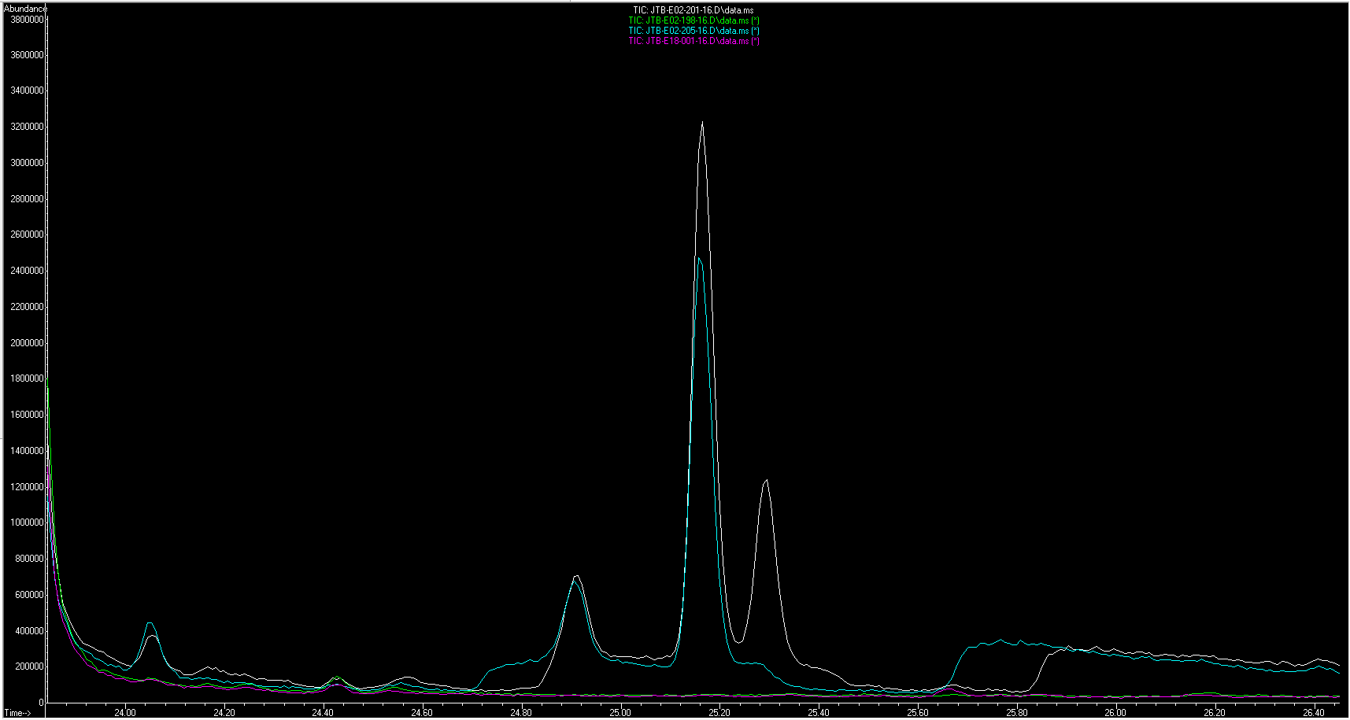
Volatile Emission 48-hours After Inoculation
F. faeni
1.2mL Juice and 10.8mL of LB broth
RT= 25.287
Endo-borneol

Slide 9
Sampling Foraged Strawberries
 | Whole Berries
15 SWD for 1hour | 3
0 SWD for 1 hour | 3

Slide 10
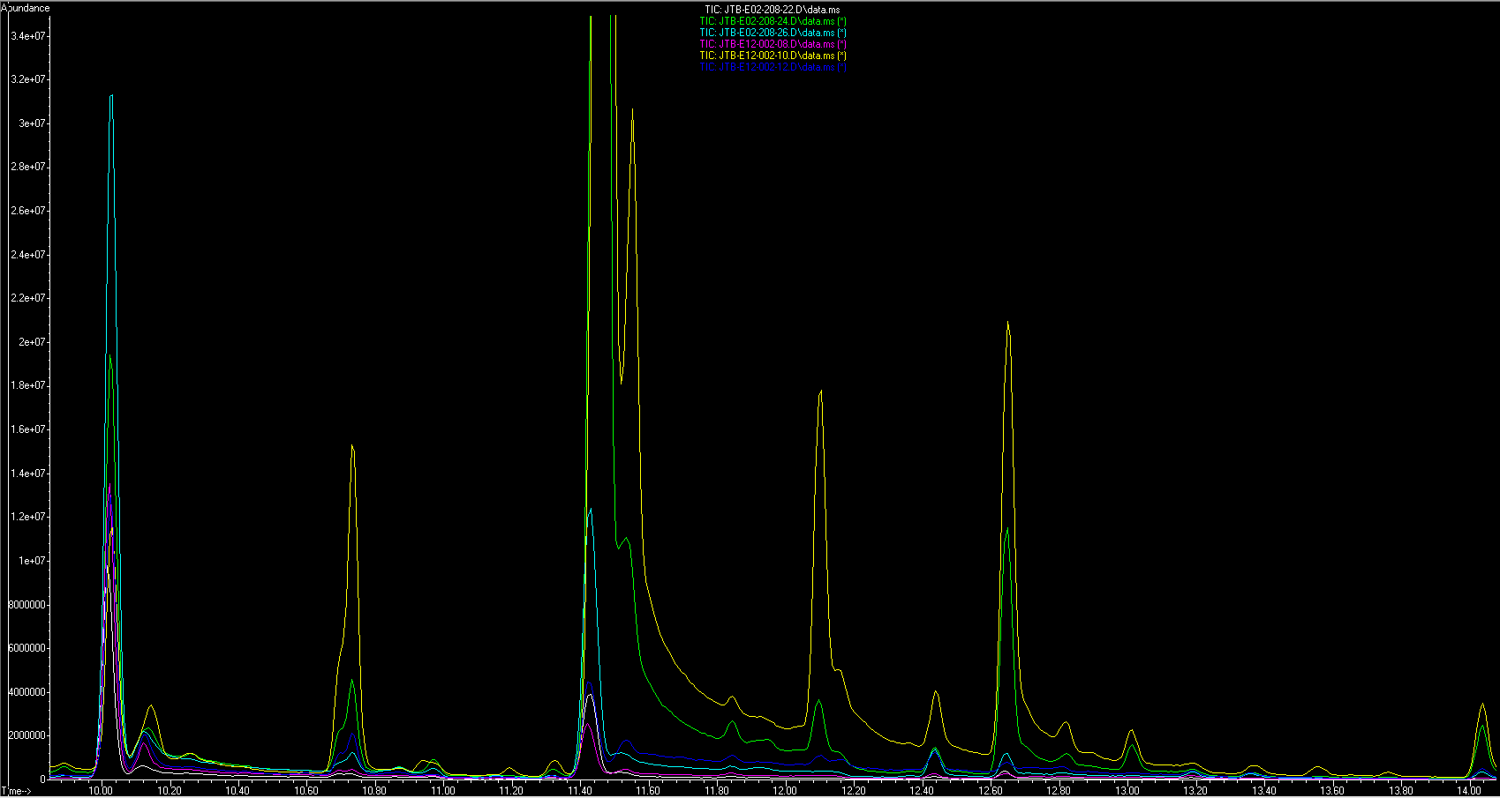

Slide 11
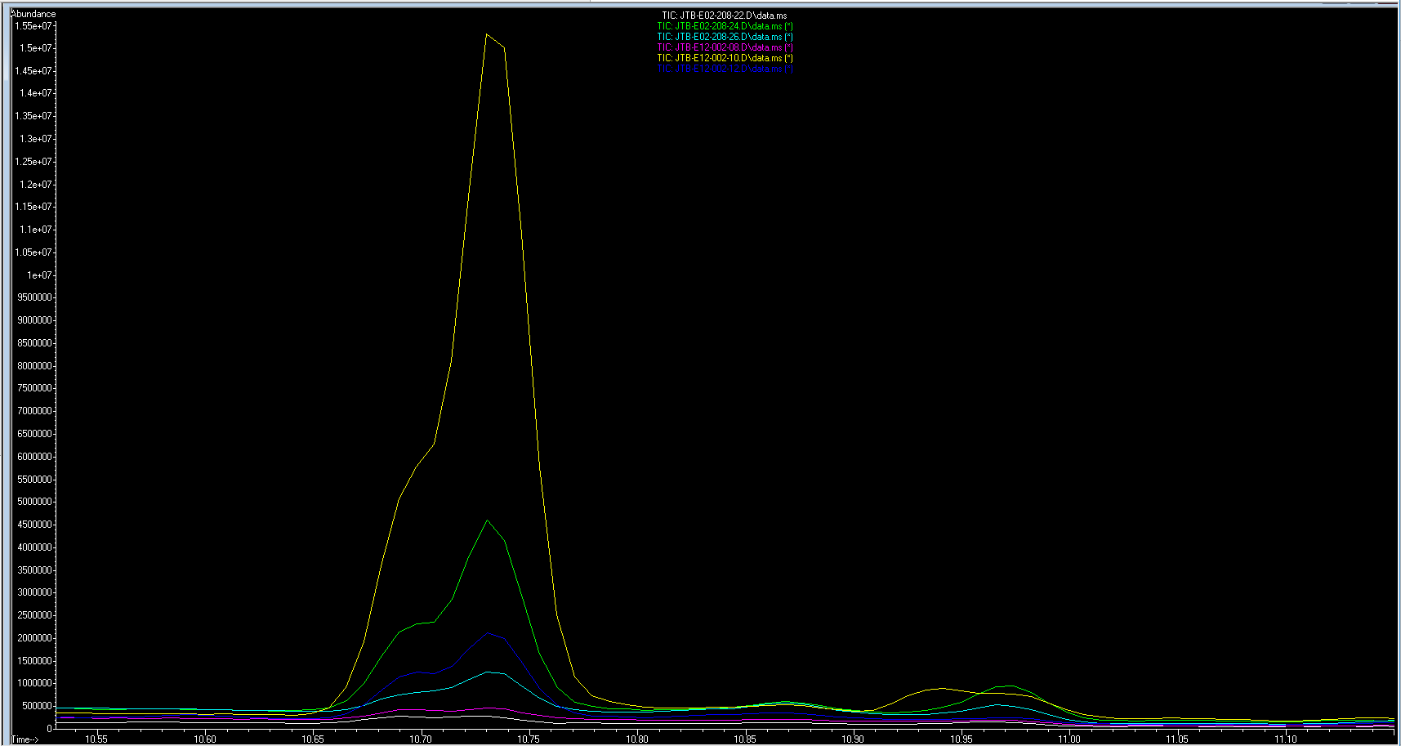
3-Methyl 1-Butanol
Control 2
Control 2
Control 1

Slide 12
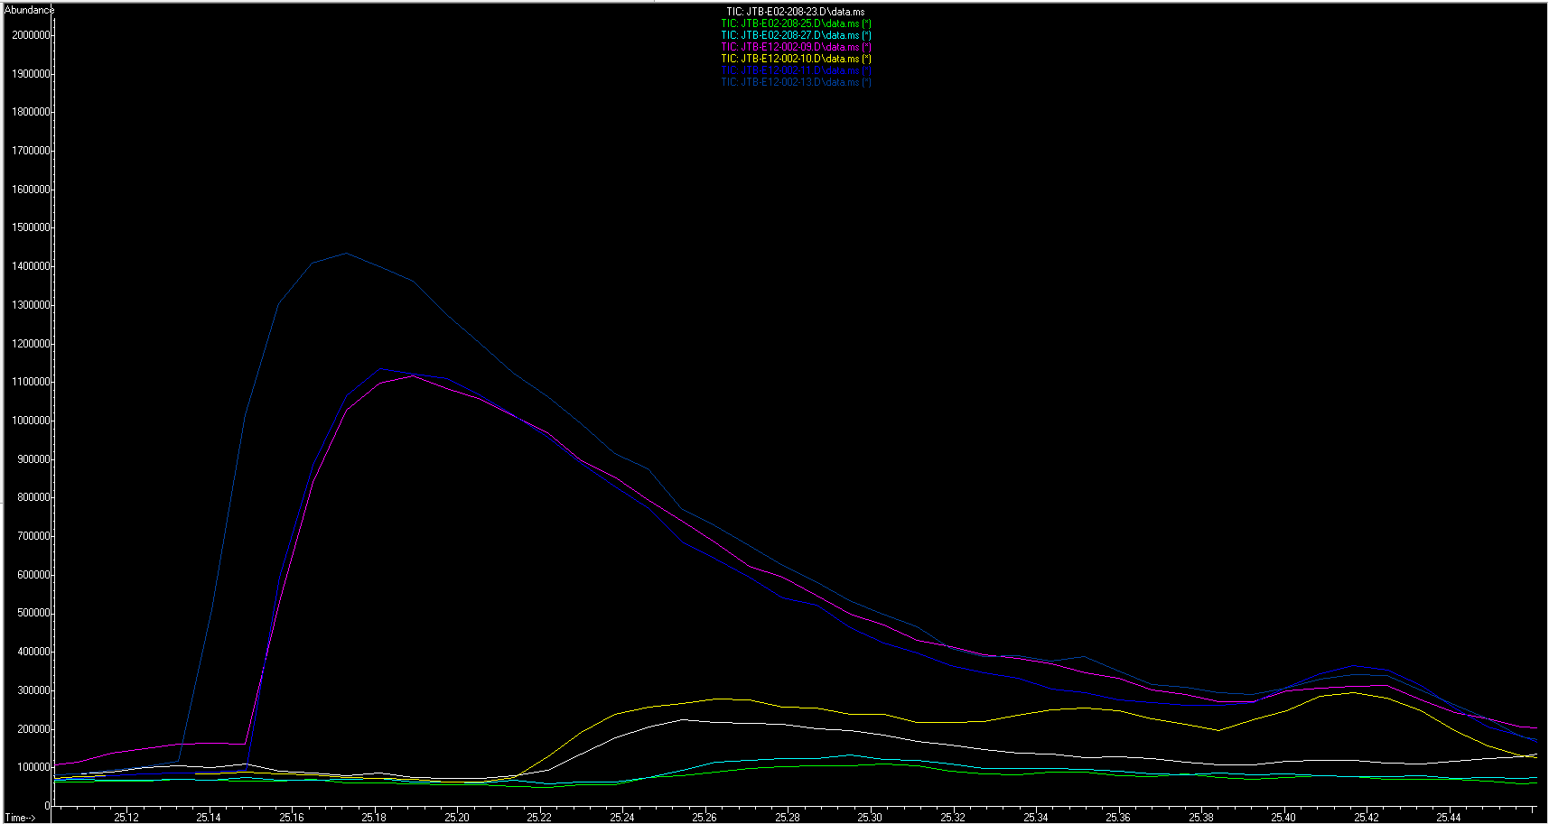
2-Methyl Hexanoic Acid
48 Hours

Slide 13
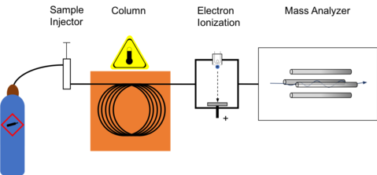
How GC-MS Works to Analyze HS volatiles

Slide 14
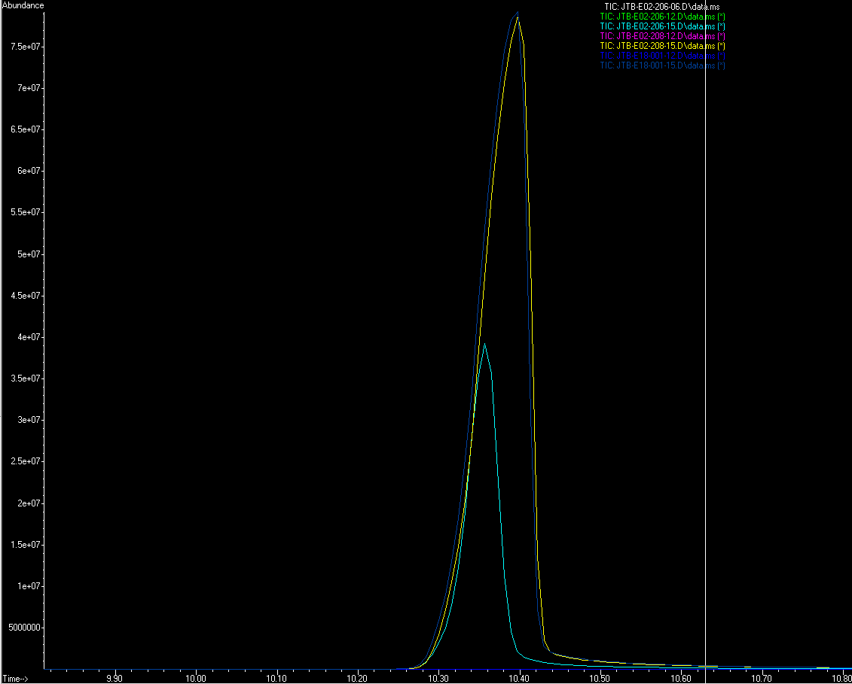
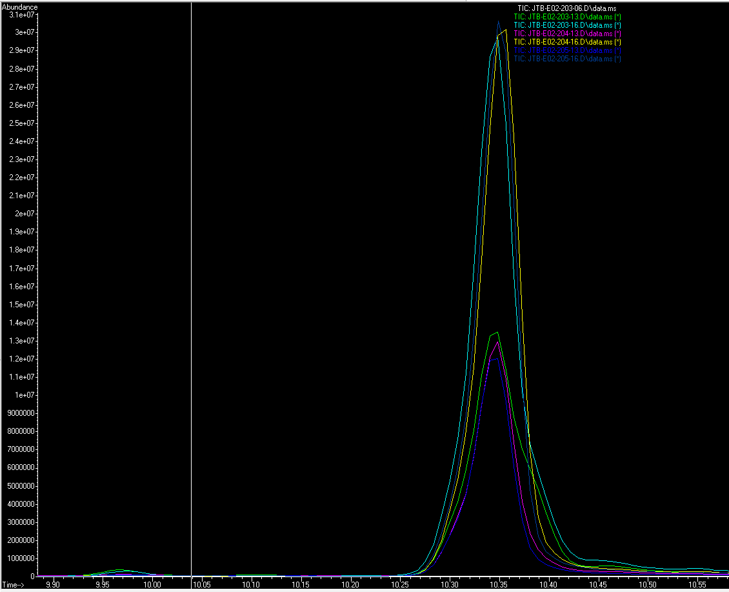
PA Broth (L) : PA 10% juice (R)

Slide 15
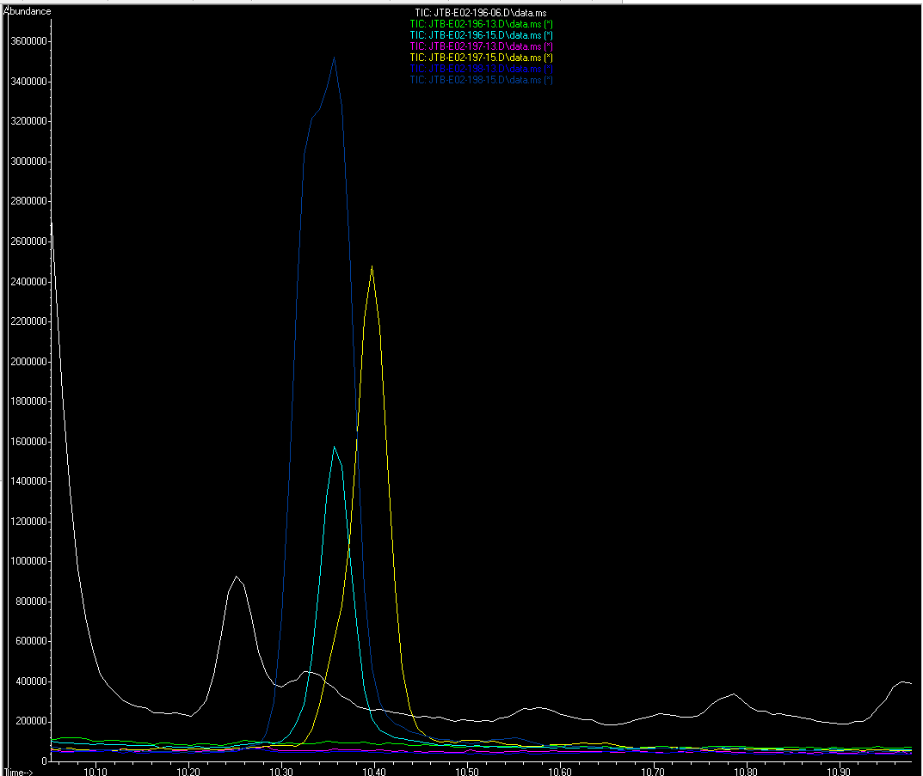
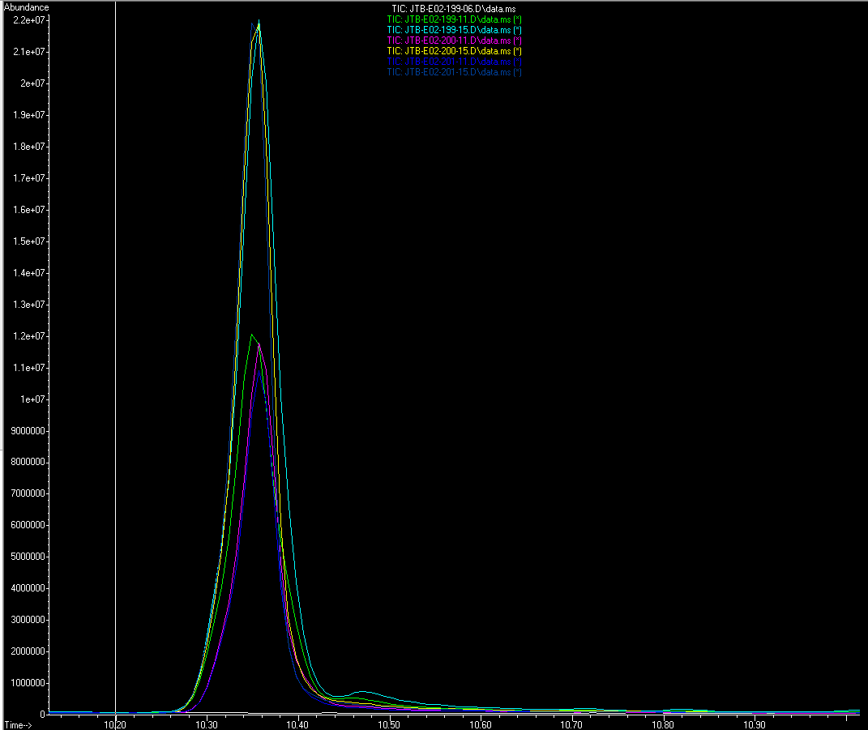
FF Broth (L) : FF 10% juice (R)

Slide 16
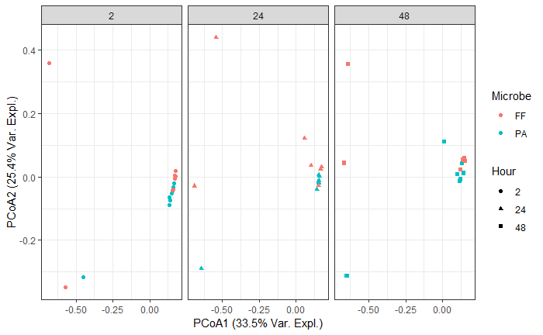
PCoA of Bacteria in Blueberry Juice

